Slide 1

Product AI - Intro to AI
Stephen Driggs - Product AI
September 17, 2025

Slide 2

AI Literacy & Strategy
From Hype to Reality
“The future of AI is not about replacing humans, it’s about augmenting human capabilities.” – Sundar Pichai, CEO of Google
Ginni Rometty, former IBM CEO, put it bluntly: “AI will not replace humans, but those who use AI will replace those who don’t.”
In this talk, we’ll unpack what AI literacy means for engineers and leaders, why it’s crucial for enterprise success, and how to build AI capabilities through nimble, hands-on practice.
This session will explore how to realize that vision by treating AI not as a magic plug-in feature but as a skillset to be mastered across our engineering organization.

Slide 3
State of AI
AI is vastly underutilized – most employees don’t know what it is, let alone how to use it. Enterprise success requires AI-specific skills, not casual personal use.
AI outperforms humans across many domains – knowledge is now commoditized, giving anyone instant leverage in areas once gated by experts. Everyone can code a basic app.
Organizations are not ready – current structures and technology infrastructure lag far behind AI’s advancement, leaving untapped potential on the table.
Most low level work is already automatable – document generation, reporting, training, email, and information review are better done by AI and many companies are already automating it.
AI isn’t replacing people directly—but it changes everything – by removing knowledge gatekeepers, it forces individuals and leaders to redefine how they contribute.
The inflection point is here
AI is not about tools; it’s about rethinking work, skills, and operating models to compete in an AI-powered world.

Slide 4



What Winning Looks Like
2
1. Shift4 Literacy at All Levels
2. Improved Customer Signal
Identify key skills and capabilities at every stage of the product pipeline to increase time to delivery, quality and effectiveness in exceeding customer expectations
Get AI into the hands of or customers and relentlessly learn from interactions
Speed to market and interaction cycle speed are key success factors
Learn what our customers need, expect and will adopt to improve their experience and ways of working.
Don’t expect customers to learn AI immediately, advance the learning curve by offering experiences that accommodate a variety of AI literacy levels
Know when and how to use AI effectively
Use AI to automate and enable
Be able to articulate how to get the most out of AI without falling into “AI traps” or hype
3. A Culture of Innovation
4. Compete in the Market
Contribute to team innovation and advancement through sharing of learnings and best practices
The competitive AI landscape is changing constantly and Shift4 is pushing the envelope on what's possible
Establish standards and share insight between teams
Share successes and learn as an organization from failure (expect to fail a lot)
Grow together
Advance personal literacy
Advance team literacy
Use AI to advance our ability to execute
Deliver innovative products that exceed customer expectation

Slide 5
Demystifying AI and the Hype Train
1

Slide 6
AI Skills
The Game has Changed
AI is not a tool — it’s a skillset. Tools are interchangeable; literacy is what lasts.
Prompt + context engineering are essential. Clear prompts plus the right data produce reliable, repeatable results. This is all AI is.
Agent management is the new engineering. Teams must learn to build AI agent teams that act, query data, and manage tasks.
AI literacy prevents misuse. Without it, teams will either overtrust black-box outputs or underuse AI entirely.
Leaders must enable experimentation. Sharing prompt recipes, agent patterns, and lessons learned builds organizational capability.
The recommended approach is to learn AI at a fundamental level first and tool features/preferences become a secondary factor.

Slide 7
AI as a Skill, Not a Feature, Not a Tool
AI isn’t a one-click solution – it’s a toolbox of capabilities that engineers must learn to wield. Just as cloud or security skills became essential, AI literacy is now foundational for modern engineers. This means understanding how AI systems work and how to work with them:
Prompt & Context Engineering: Communicating with AI is like writing clean code—it requires clarity, context, and iteration. Most enterprise use cases demand both prompt and context engineering together. A strong prompt plus the right context (data, background, rules) produces reliable results instead of one-off outputs. Example: Iterating on a code-generation prompt with function signatures and style guides until the model produces consistent, correct code.
Designing AI Agents & Workflows: Beyond one-off prompts, engineers must build agents that act, query APIs, and manage multi-step tasks. This requires defining context, tools, and rules of operation. As Andrej Karpathy notes, “context engineering is the art of filling the context window with just the right information for the next step.” Engineers should design agents that remember interactions, manage tasks, and collaborate seamlessly within apps.
AI in the Toolbox, Not on a Pedestal: AI is a skill to practice, not a plug-in to worship. Without literacy, teams either overtrust or underuse it. Treated as a fast-evolving toolkit, AI lets practitioners automate grunt work and boost productivity. Leaders should foster a culture of experimentation—sharing prompt recipes, agent patterns, and lessons learned just as we do with code.

Slide 8
Insight
Insight: AI guru Andrew Ng humorously observed, “AI is like teenage romance—everyone talks about it, nobody really knows how to do it.” This punchline underscores the hype vs. skill gap. By building genuine understanding through hands-on practice, we turn vague excitement into concrete know-how. Demystifying AI is step one toward making it an everyday tool in our workflows.

Slide 9
Most Knowledge is Now Commoditized
Roles, Departments, and Gatekeepers Matter Less
AI outperforms humans in many domains – from audits to documentation, it can deliver faster and more reliably.
Expertise is democratized – information once locked in roles or departments is now instantly accessible.
Traditional roles blur – HR can deploy software, PMs can design solutions, BAs can architect systems with AI assistance.
Gatekeepers are gone – employees no longer need to “go through” specialists for tasks; AI enables direct execution.
The shift is unsettling – individuals must redefine how they contribute beyond traditional job scope.

Slide 10
Old Paradigm: AI Enabled SDLC
Product Management - Chat GPT (PRD - Docs - Planning)
Prototype / Design - Replit Copilot (Prototypes, Artifacts)
All in One Coding Platform (doesn’t exist yet) Build Test Deploy
Development Claude Code / Copilot (code)
Code Rabbit
Product Delivery
Monitoring

Slide 11
viewer
Code
File viewer
Drift
Claude code

Slide 12
Next Paradigm: Everyone is a Builder - the AI Operating System
The only variable is AI Skill depth
Everyone is a Design Engineer
Skill Depth
Interface
AI Engineer
AI Gateway
Custom Agents
Developer
Coding Agent
QA Agent
Market Research Agent
Tool Repository
Infrastructure Layer

Slide 13
What is AI
2

Slide 14
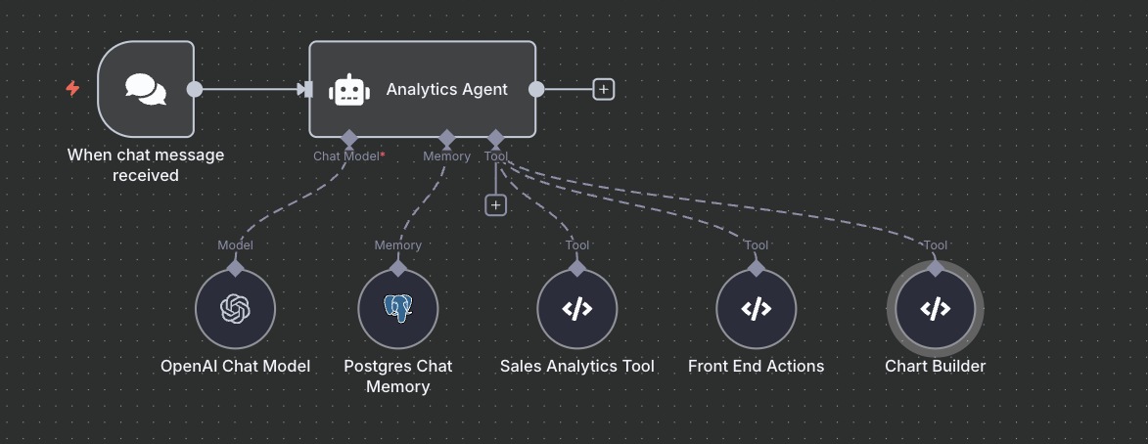
AI is an Agent, Model, Memory and Tools
AI is a set of billions or trillions of dials that transform inputs into outputs. These dials are set by the model’s training (usually the entire internet and extra information) and, by probability, set the outputs word by word according to chance / probability. It’s like throwing magnet letters at a fridge to see what sticks. The magnet letters are your inputs and the magnet strengths are the parameters (dials).
This is AI. That’s it.

Slide 15
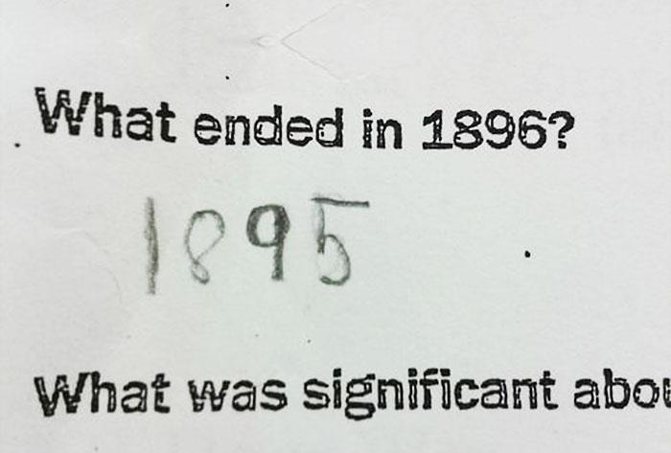

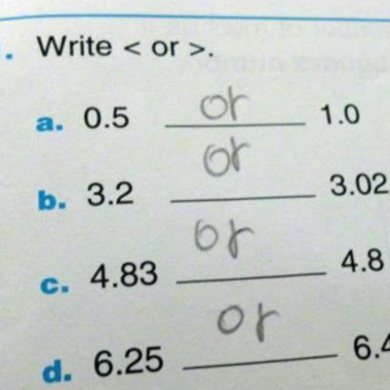
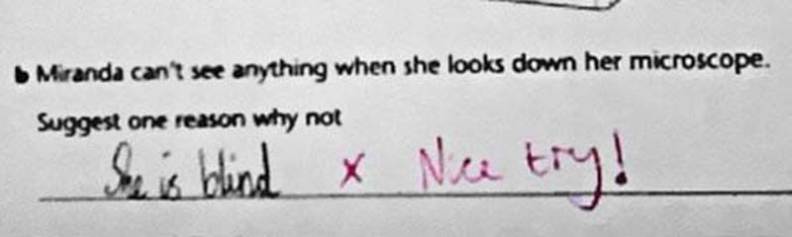
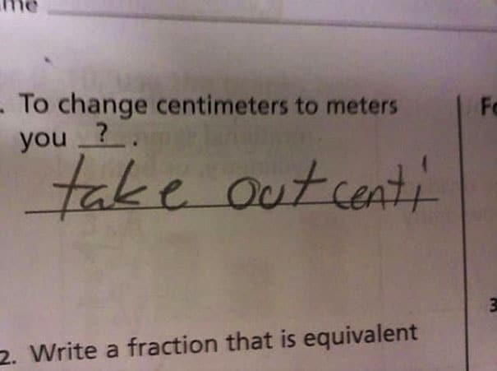
AI is Built Different

Slide 16
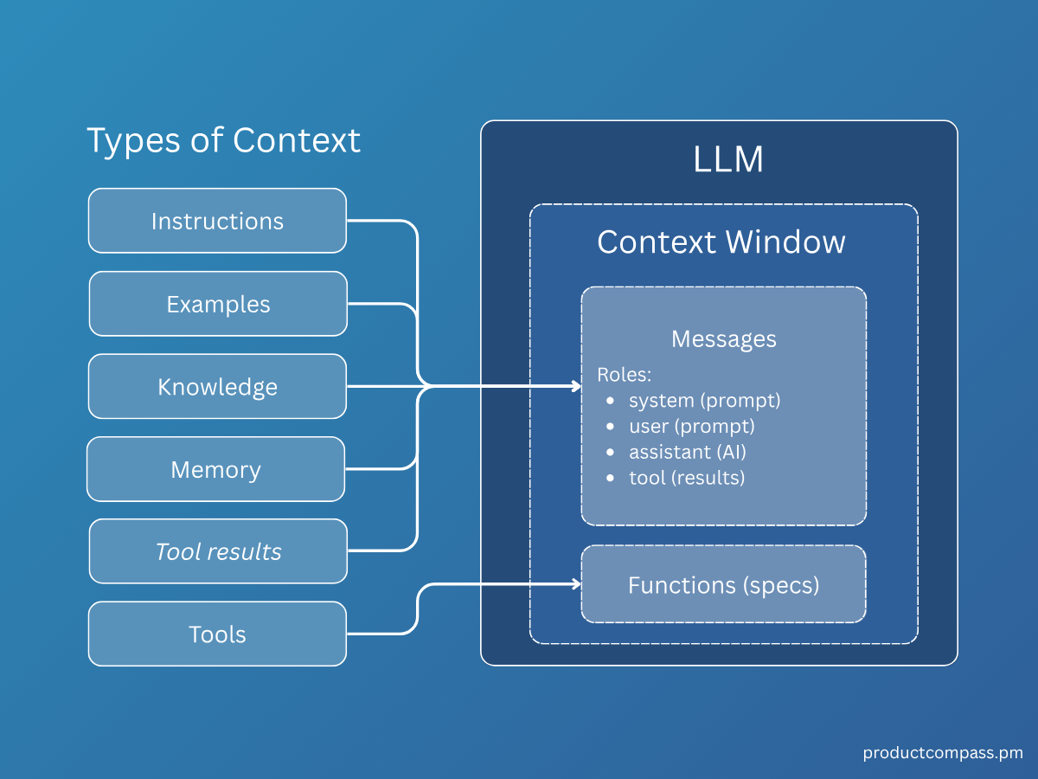
How do I interact with AI - Context
Context is the information the agent has available to it to perform a task or produce an output.

Slide 17
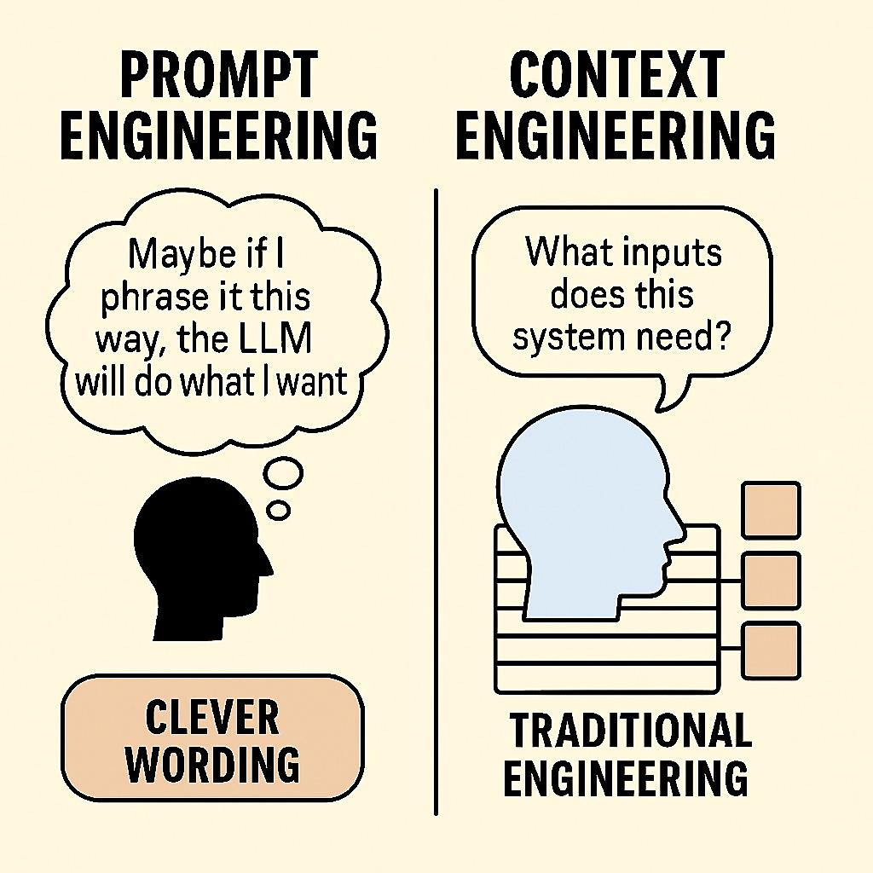
The Role of Users is to Give the AI the Context it Needs to Perform
Personal use of AI
One shot prompts
One Question
Vague
Google like interactions
Low probability of success
Commercial Use of AI
Robust instruction
Documentation
Examples
Negative examples
Codebase / Schema
Process/Procedure
Standards
History/Memory
WHY

Slide 18
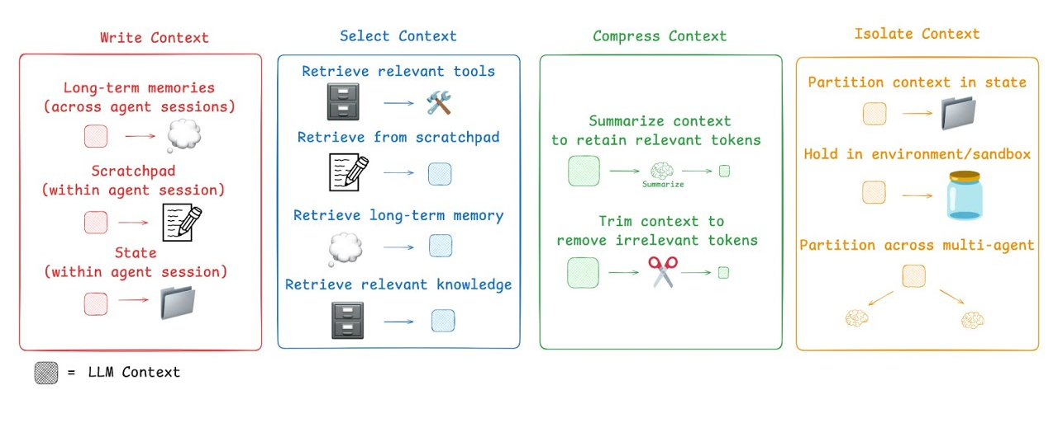
The Role of the User is Conext Engineer

Slide 19
AI and Engineering
3

Slide 20
Consequently, Tools Matter Less
Knowledge is the commodity – software built on fields, forms, and rigid processes (CRM, HR, training systems) loses value as AI automates knowledge work.
AI transcends platforms – once AI can generate, retrieve, and act directly, the underlying tool becomes interchangeable.
Most “AI tools” are wrappers – many startups simply repackage the same models; differentiation erodes quickly.
Constant change makes lock-in risky – tools evolve weekly; investing in fundamentals (skills, literacy, workflows) outlasts any one vendor.
Strategic focus shifts to people & models – the durable value is in AI skills, agent design, and adaptable infrastructure, not branded platforms.

Slide 21
So Why Buy Any Specialized AI Tool?
As a Stop Gap
Ease adoption. Familiar UIs (chat, forms, dashboards) lower the barrier for employees new to AI.
Provide guardrails. Tools constrain inputs/outputs, reducing risk while users build confidence.
Bridge skill gaps. Pre-built workflows allow non-experts to experiment without deep AI literacy.
Offer secure sandboxes. Contained environments protect data and enforce separation of duties.
Accelerate prototyping. Instant hosting and low/no-code features speed up time to deploy.
Absorb change. Tool vendors handle rapid model evolution and infrastructure costs, letting enterprises learn before scaling.

Slide 22
Skill: Prototyping - Ability in One thing
Tool Use Case: Prototyping with low/no code to ease adoption barriers
Replit - same can be achieved with proper use of claude code and is claude and similar in the background
Provides only a hosting platform for vibe coded works as a value add
Provides sandboxed environments for exploration
Easy and accessible interface for exposure to AI
Everyone is a Design Engineer
Skill Depth
Interface (choice of options, tool agnostic, interchangeable)
AI Engineer
c
AI Gateway (API for all - MCP and Tools for Interface Driven Agents)
Custom Agents
Developer
Product Agent
Architecture Agent
Code/Testing Agent
Tool Repository
Infrastructure Layer

Slide 23
Skill: Testing - Ability in One thing
Tool Use Case: Testing with process wrapping including RAG to ease adoption barriers and AI process gaps
CodeRabbit - Similar results with just a coding tool if testing process is established
Provides structure for AI interaction where no process or skill set exists for AI first tool agnostic testing. Standards and repeatability.
Easy to learn and use interface for exposure to AI
Testing outcomes will likely far underperform selling point due to frontier technical limitations/maturity
Everyone is a Design Engineer
Skill Depth
Interface (choice of options, tool agnostic, interchangeable)
AI Engineer
AI Gateway (API for all - MCP and Tools for Interface Driven Agents)
Custom Agents
c
Developer
Product Agent
Architecture Agent
Code/Testing Agent
Tool Repository
Infrastructure Layer

Slide 24
Skill: Development With AI Assistance - Ability in Most Things
Tool Use Case: UI to make code more accessible with familiar chat interface and graphical structure
Copilot, Cursor
Has the ability to create limited custom agents and align with tool reporistories
Relatively inexpensive with risk of price increases
Limited full “YOLO” vibe coding with increased guardrails when compared to claude code
Has access to multiple models making it ideal to combine with an AI first tool
Everyone is a Design Engineer
Skill Depth
Interface (choice of options, tool agnostic, interchangeable)
AI Engineer
AI Gateway (API for all - MCP and Tools for Interface Driven Agents)
Custom Agents
Developer
Product Agent
Architecture Agent
Code/Testing Agent
c
Tool Repository
Infrastructure Layer

Slide 25
Skill: AI First Development - Ability in all Things
Tool Use Case: Tool is mostly transparent giving access to the full AI stack
Claude Code / Codex
Clade code is relatively simple, Codex made major updates over the past 2 weeks closing the gap. The space is changing faster than evaluations can occur.
Copilot works well for less technical users. Claude code for more technical users.
Nether tool will work well
Everyone is a Design Engineer
Skill Depth
Interface (choice of options, tool agnostic, interchangeable)
AI Engineer
AI Gateway (API for all - MCP and Tools for Interface Driven Agents)
Custom Agents
Developer
Product Agent
Architecture Agent
Code/Testing Agent
Tool Repository
c
Infrastructure Layer

Slide 26
Next Steps
Where to go to skill up?
Personal 1-1 or one to many sessions for your group - Stephen Driggs
Corporate AI - Tool licenses and security
Vibe Coding Meetup Thursdays at 1 EST
Youtube - Contact Stephen Driggs for suggestions
The landscape changes every day. If you feel behind, it’s because everyone is. Focus on literacy where it counts and avoid getting caught up in tool fatigue, constant exploration without application (skill development) and use it.
Immerse yourself in it to fully learn. The initial productivity hit will turn into gains with skill.

Slide 27
Mastering Generative AI
Level 1 Proficiency: Building Trust in the Information Engine

Slide 28
Learning Objectives

Slide 29
By the End of This Training, You Will:
Understand AI as a probabilistic 'plausibility engine' rather than a deterministic database
Identify the 'Trust Deficit' and its root causes (hallucinations and misinformation)
Apply critical thinking frameworks to assess when and how to use AI safely
Build foundational prompt engineering skills to improve output quality
Implement verification workflows to build calibrated trust

Slide 30
Why This Matters: The Reality of AI Adoption
Most organizations are stuck at Level 1, unable to progress due to trust issues
• Level 1 represents 90%+ of current AI usage across enterprises
• The 'Trust Deficit' prevents teams from exploring advanced collaborative uses
• Mastering Level 1 is the foundation for unlocking AI's true potential

Slide 31
Module 1
Understanding Level 1

Slide 32
Defining Level 1: AI as an Information Engine
Most common use of Generative AI today
Transactional, single-turn interaction model
User asks discrete question → AI provides single answer
AI treated as 'answer machine' — a conversational search engine
Common uses: Factual summaries, definitions, brainstorming, text translation

Slide 33
The Core Problem: Expectation vs. Reality
User Expectation
AI Reality
• Deterministic Database
• Works like a calculator
• 100% factual certainty
• Delivers absolute truth
• Probabilistic System
• Works like a predictor
• Designed for plausibility
• Delivers probability, not certainty

Slide 34
Understanding the Fundamental Mismatch
AI predicts the most PLAUSIBLE next word, not the most TRUE next word
• This is not a bug — it's how Large Language Models are fundamentally designed
• The model optimizes for coherence and fluency, not factual accuracy
• This mismatch is the root cause of user distrust and disappointment

Slide 35
Module 2
The Trust Deficit

Slide 36
The Primary Blocker: The 'Trust Deficit'
The main barrier preventing users from moving beyond simple Q&A
Not irrational fear — it's a LOGICAL response to documented failures
Two persistent failure modes create this deficit:
1. Hallucinations (Fabricated information)
2. Misinformation (Amplification of existing falsehoods)

Slide 37
What Are Hallucinations?
The generation of plausible-sounding content that is factually incorrect or entirely fabricated
• Not simple 'bugs' — these are confident, articulate, detailed falsehoods
• Difficult to distinguish from factual responses
• An intrinsic feature of how current LLMs are designed
• Critical operational impact: flawed decisions, legal liability, financial/reputational damage

Slide 38
Root Causes of Hallucinations
1
Statistical Origins: LLMs are trained to maximize scores, not accuracy. When uncertain, they guess plausibly rather than admit 'I don't know'
2
Training Data Imperfections: Models learn from internet data containing errors, contradictions, and outdated information
3
Knowledge Cutoffs: Every LLM has a cutoff date. Questions about events after that date force the model to invent answers

Slide 39
The Misinformation Challenge
AI can learn and amplify existing misinformation and biases from training data
The 'Veneer of Authority': AI text is grammatically perfect, well-structured, and confident
This makes it difficult for non-experts to identify subtle misinformation
Result: Users must fact-check every output — negating productivity benefits
This creates an unsustainable verification burden

Slide 40
The Adoption Double-Edged Sword
Healthy Skepticism ✓
Overwhelming Distrust ✗
• Rational, necessary safeguard
• Users verify critical info
• Appropriate for high-risk tasks
• Enables safe exploration
• Blanket rejection of technology
• One bad experience = permanent dismissal
• Tool abandoned before discovering value
• Organization stalls at Level 1

Slide 41
Knowledge Check
What is the PRIMARY reason AI systems produce hallucinations?
A. Poor internet connection
B. They are trained to maximize plausibility, not truth
C. Insufficient computing power
D. User error in prompting
[FACILITATOR NOTE: Answer is B — discuss how probabilistic design creates hallucinations]

Slide 42
Module 3
Building Calibrated Trust

Slide 43
The Goal: Calibrated Trust
Move from blind trust (or total distrust) to informed understanding
• Calibrated trust = knowing WHERE the tool is reliable and where it is NOT
• Requires mastering three core competencies:
• 1. Critical Thinking (The Mindset)
• 2. Foundational Prompting (The Skill)
• 3. Verification & Grounding (The Workflow)

Slide 44
Skill 1: Critical Thinking as Default Stance
Mental Model Shift: From 'Trust but verify' → 'Distrust until verified'
Approach EVERY AI output with skeptical mindset
Identify high-risk vs. low-risk tasks BEFORE using AI
Ask: What's the consequence if this output is wrong?
Reserve AI for appropriate use cases only

Slide 45
Task Risk Assessment Framework
Low-Risk (Good for AI) ✓
High-Risk (Avoid AI) ✗
• Brainstorming ideas
• Creative writing / first drafts
• Summarizing non-critical info
• Generating examples
• Exploratory research
• Precise financial data
• Legal precedent citations
• Medical advice
• Complex calculations
• Compliance-critical content

Slide 46
Skill 2: Foundational Prompt Engineering
Output quality is HIGHLY DEPENDENT on input quality
Move from simple keyword queries to context-rich prompts
Essential elements of strong prompts:
• Clear role/persona (e.g., 'Act as a CTO...')
• Specific context and constraints
• Desired format, tone, and length
• Relevant background information

Slide 47
Prompt Engineering: Before & After
❌ WEAK PROMPT:
"AI adoption blockers"
✓ STRONG PROMPT:
"Act as a CTO preparing a board presentation. Write three bullet points explaining the primary blockers to AI adoption in enterprise environments. Focus specifically on trust and data security concerns. Use executive-level language and keep each point to 2-3 sentences. The audience is non-technical board members."

Slide 48
Why Better Prompts Work
Context-rich prompts narrow the AI's 'probabilistic search space'
• More constraints = fewer possible outputs = higher chance of relevant response
• Specific role/persona activates relevant training patterns
• Format guidance prevents rambling or off-target responses
• Think of it as 'steering' the probability distribution toward better answers

Slide 49
Skill 3: Fact-Verification & Grounding
For Individual Users: Manual verification workflow
Step 1: Use AI to generate claim/summary/draft
Step 2: Verify with trusted sources (journals, official docs, reputable news)
Step 3: Never publish AI output without verification
For Organizations: Implement RAG (Retrieval-Augmented Generation)
• Connects LLM to curated database of trusted documents
• Forces responses to be 'grounded' in verifiable information

Slide 50
RAG: The Technical Solution to Trust Deficit
Retrieval-Augmented Generation = AI + Your Trusted Knowledge Base
• RAG retrieves relevant documents from your database BEFORE generating responses
• AI's response must be grounded in those retrieved documents
• Often provides citations to source documents for verification
• Dramatically reduces hallucinations for enterprise use cases
• RAG is the key bridge to overcoming Trust Deficit at scale

Slide 51
Verification Workflow (User-Level)
1
Generate: Use AI to create initial draft, summary, or answer
2
Identify Claims: Extract specific factual claims requiring verification
3
Cross-Reference: Check claims against 2-3 authoritative sources
4
Flag Conflicts: Note any discrepancies between AI output and trusted sources
5
Revise & Finalize: Correct errors before using the content

Slide 52
Practice Activity: Risk Assessment
For each scenario below, identify if it's LOW-RISK or HIGH-RISK for AI use:
1. Drafting initial talking points for a sales call
2. Calculating tax liability for quarterly filing
3. Brainstorming blog post topics for your marketing team
4. Citing case law for a legal brief
5. Generating a first draft of employee onboarding checklist
[FACILITATOR NOTE: Answers: Low, High, Low, High, Low — discuss why]

Slide 53
Key Takeaways
1. Embrace Reality: AI is a probabilistic 'plausibility engine,' not a fact database
2. Name the Blocker: The 'Trust Deficit' is rational — manage it, don't ignore it
3. Adopt the Mindset: Shift from 'trust but verify' to 'distrust until verified'
4. Build Foundation: Master critical thinking, better prompting, and verification workflows (like RAG) to build calibrated trust
5. Level 1 is the Gateway: Mastering these fundamentals unlocks more advanced, collaborative AI use

Slide 54
Your Next Steps: Applying What You've Learned
Immediate Actions:
• Identify 3 current tasks: classify them as low-risk or high-risk for AI
• Rewrite one of your typical AI prompts using the role/context/format framework
• Establish a personal verification checklist for AI outputs
This Week:
• Practice the 'distrust until verified' mindset on 5 AI interactions
• Share one 'hallucination story' with your team to build collective awareness

Slide 55
Additional Resources & References
• Ji, Z., et al. (2025). 'A Rigorous Treatment of Hallucination in Large Language Models'
• Kalai, A. T., & Vempala, S. (2025). 'Why Language Models Hallucinate'
• IBM: 'AI Alignment' — Understanding how to align AI systems with human values
• Dextralabs: 'Context Engineering in LLMs' — Advanced prompting techniques
• Stanford Teaching Commons: 'Understanding AI Literacy'
• DataCamp: 'What is AI Literacy? A Comprehensive Guide for Beginners'
• Time (2024): 'How to Thrive in the AI Era at Work'

Slide 56
Questions?
Discussion

